Slide 1

Project Elevate
LIFTING PRISM TO NEW STRATEGIC HEIGHTS

Slide 2
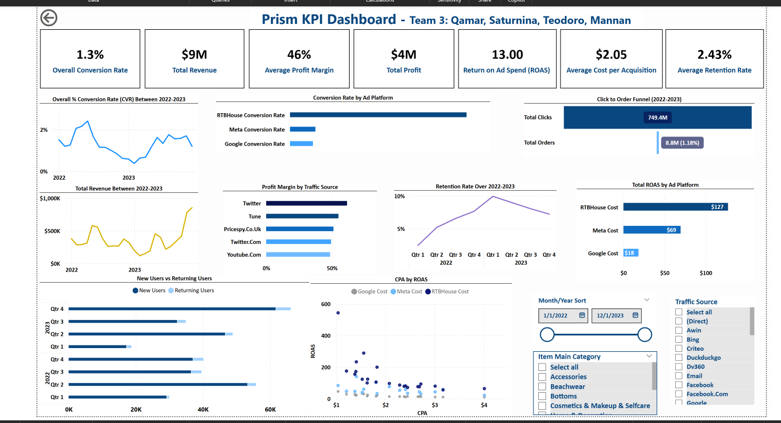
Executive Summary
Purpose:
Equip Prism with a real-time dashboard for faster, data-driven decisions
Key Insights:
Conversion stagnation: Despite peaking at 2.41% CVR plateaued in 2023. Funnel optimization is critical.
Ad spend efficiency: Google & RTBHouse outperform Meta in ROAS – budget reallocation is recommended
Retention challenge: High percentage of guest checkouts indicates the need for stronger lifecycle strategies
Summary: Prism’s growth is strong but improving retention and acquisition efficiency is crucial for sustainable success

Slide 3
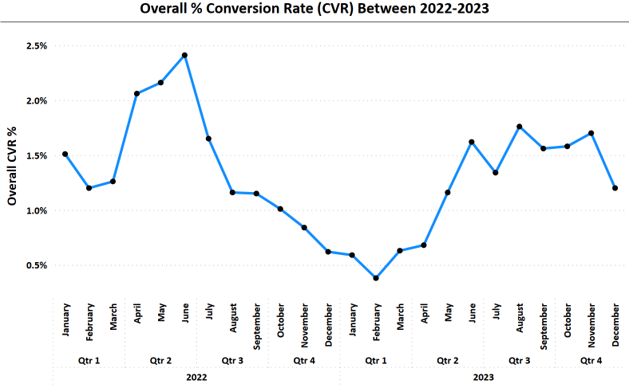
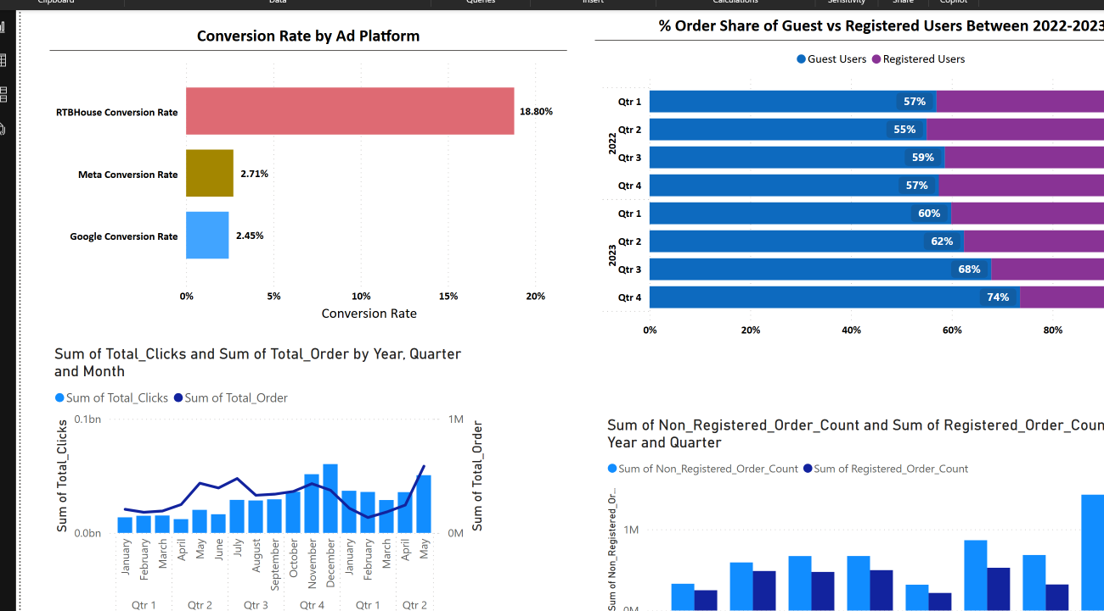
Conversion Trend & Platform Breakdown
Conversion Performance Over Time:
CVR peaked at 2.4% in Q2 - 2022, dropped sharply below 0.5% by Q1 – 2023, and recovered slightly above 1.5% by Q2 – 2023
Conversion rate by Platform:
RTBhouse has significantly better conversion efficiency compared to Google and Meta, suggesting stronger audience alignment

Slide 4
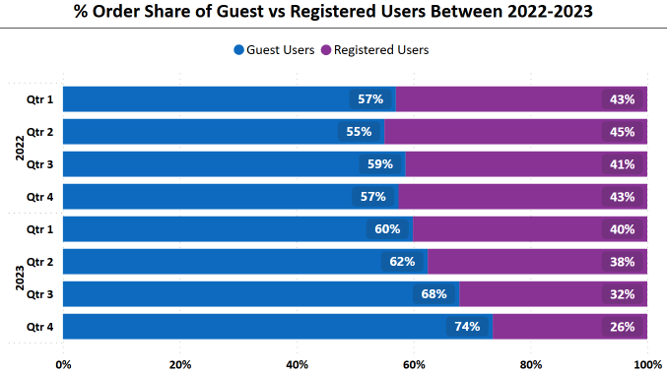
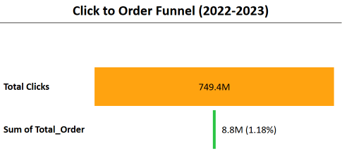
Conversion Quality & Funnel Analysis
Registered vs Guest Orders:
Over 60% of orders are made by guest users.
Opportunity to drive account sign-ups to boost retention
Funnel Chart (Clicks to Orders):
A significant drop-off occurs between ad clicks and completed orders
Click-to-order conversion at only 1.2% signalling the need to improve landing page and site performance

Slide 5
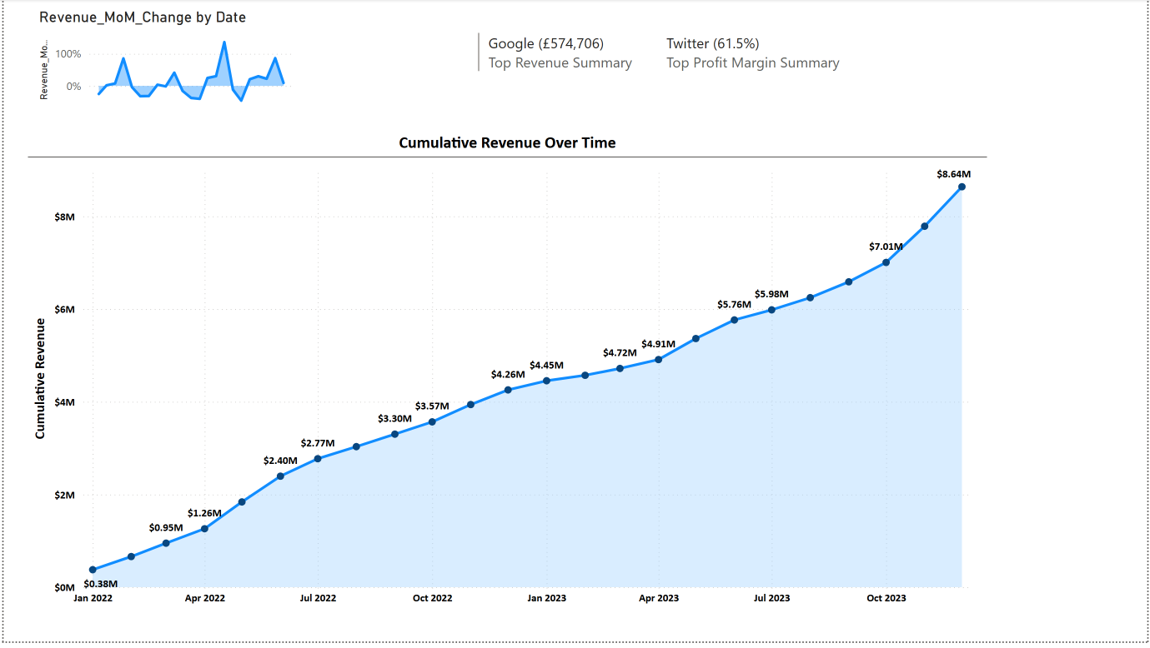
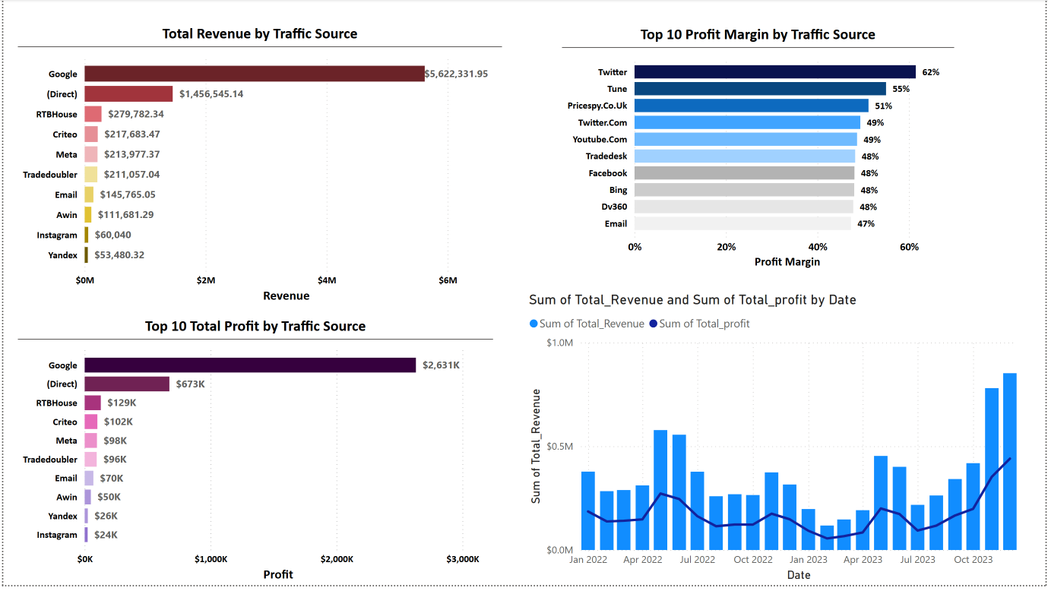
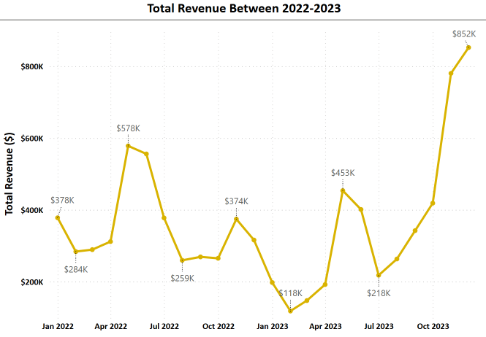
Revenue Growth & Traffic Source Contribution
Cumulative Revenue:
Over $8.6M generated to date, validating scaled channel strategies
Revenue by Traffic Source:
Google is the dominant revenue driver
There’s potential in developing under-leveraged but profitable sources
Revenue Over Time:
Steady revenue growth peaking in December at 2023 at $8.52K

Slide 6
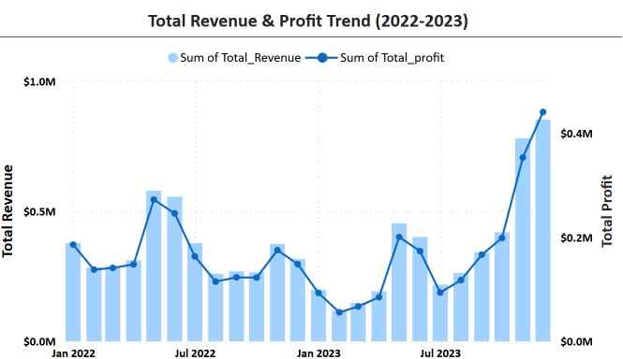
Profitability by Source
Profit Margin by Source:
Twitter, Tune, and PiceSpy deliver the highest profit margins despite lower traffic volumes
Profit by Source:
Google leads in absolute profit, balancing high traffic volumes with lower margins
Revenue + Profit Trend:
Revenue and profit growth are closely aligned, reflecting strong operational control

Slide 7
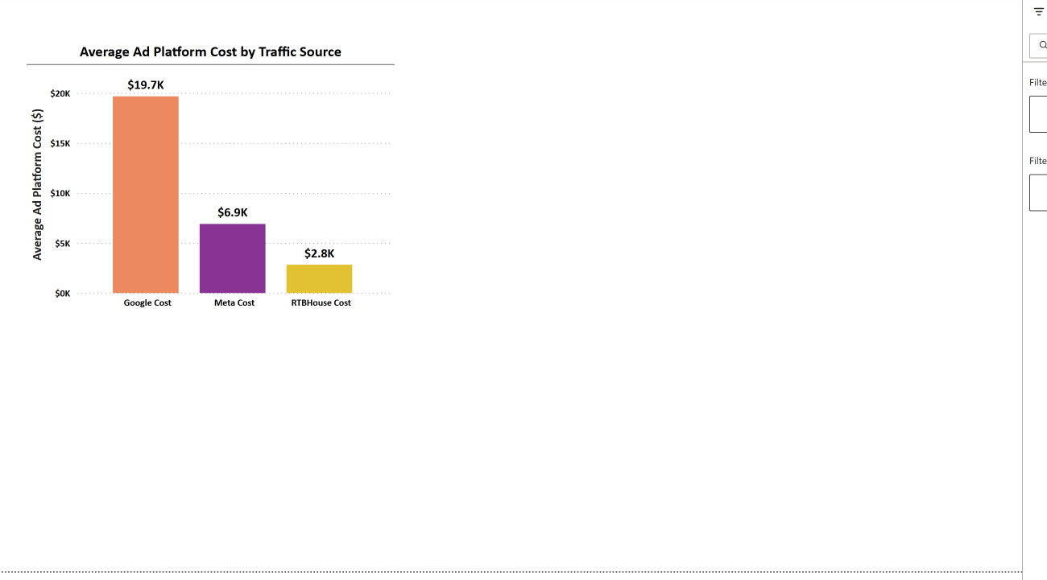
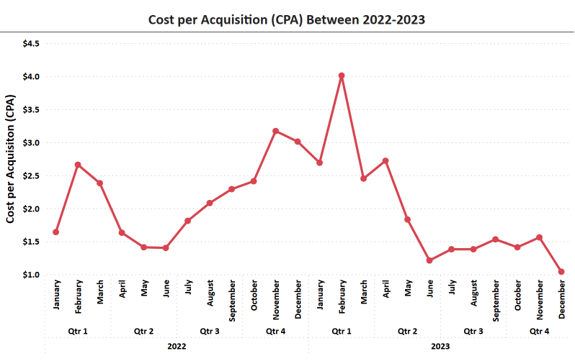
Ad-Spend & Cost Efficiency
Average Ad Cost by Platform:
Google has the highest ad spend
RTBHouse remains the most cost-efficient channel
CPA Over Time:
Significant improvement with CPA dropping from £4.01 to £1.04 over two years, showing effective campaign optimization

Slide 8
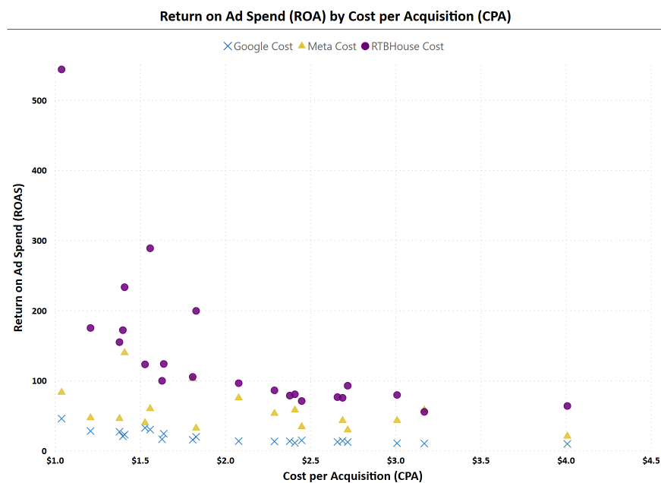
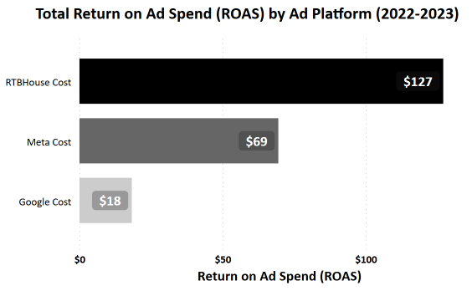
Return on Ad-Spend (ROAS) & Channel Efficiency
ROAS vs CPA:
RTBHouse offers the best cost-to-return profile (low CPA, high ROAS)
Meta appears the least efficient (high CPA, low ROAS)
ROAS by Platform:
RTBHouse delivered the highest revenue return per $1 spent ($127 total return)

Slide 9
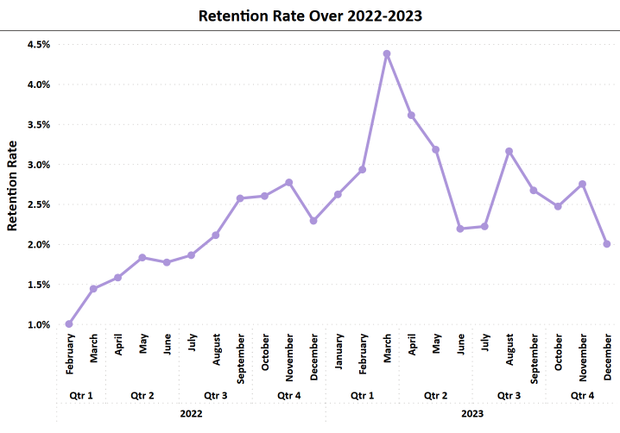
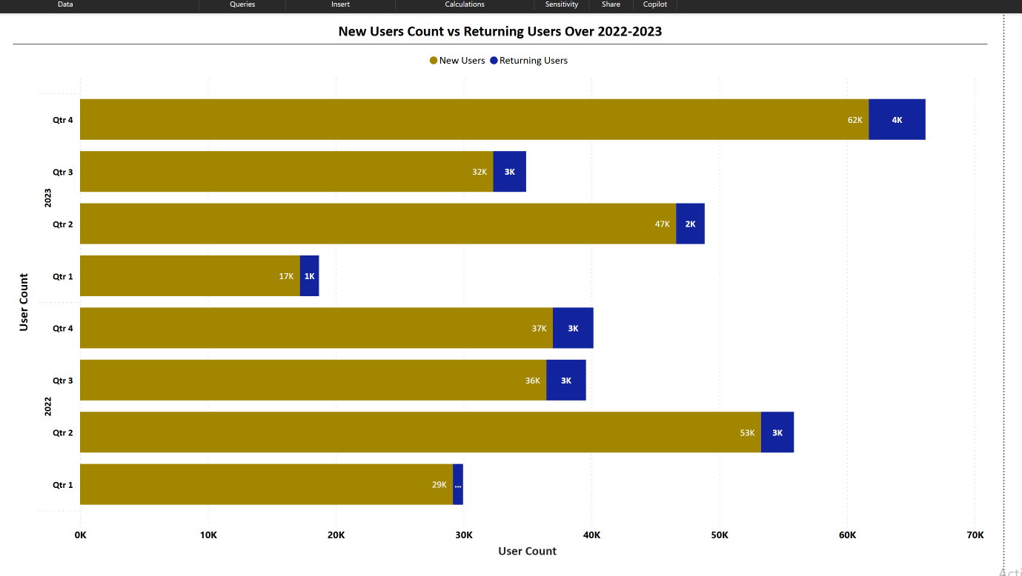
Retention & Loyalty Insights
Retention Rate Over Time:
Volatility observed with rates fluctuating between 1% and over 4%
New vs Returning Users:
Heavy reliance on new user acquisition indicates a need for better post-purchase engagement

Slide 10
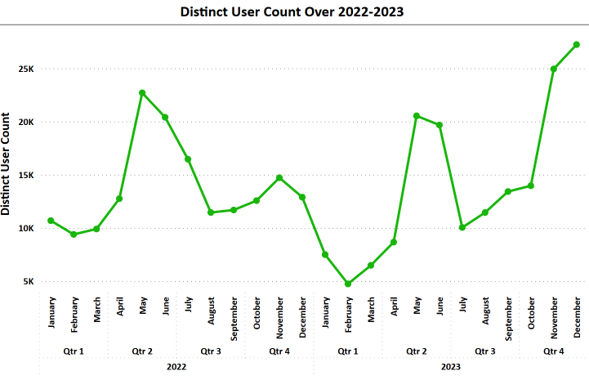
Retention Rate Insights
Monthly Distinct Users:
Active user base nearly doubled over two years, indicating growth
Future success hinges on enhancing user retention and lifetime value

Slide 11


Recommendations summary
Optimize or reallocate Meta spend to RTBHouse
Incentivize guest users to create accounts
A/B test landing pages to reduce drop-offs
Scale high-margin channels like Tune and Twitter
Implement email marketing and loyalty programs to boost retention

Slide 12


Prism & Co
THANK YOU
www.linkedin.com/in/giovannyteodoro
giovannyjoyteodoro1997@gmail.com

